Slide 1


Project name: FLIGHT PRICE PREDICTION
SUBMITTED BY
ARGHA KR MAITI

Slide 2
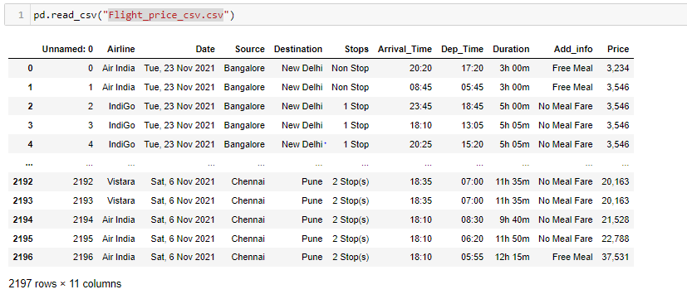
Collected Data

Slide 3
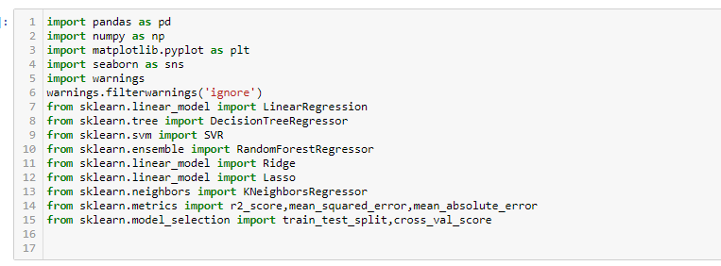
Importing libraries

Slide 4
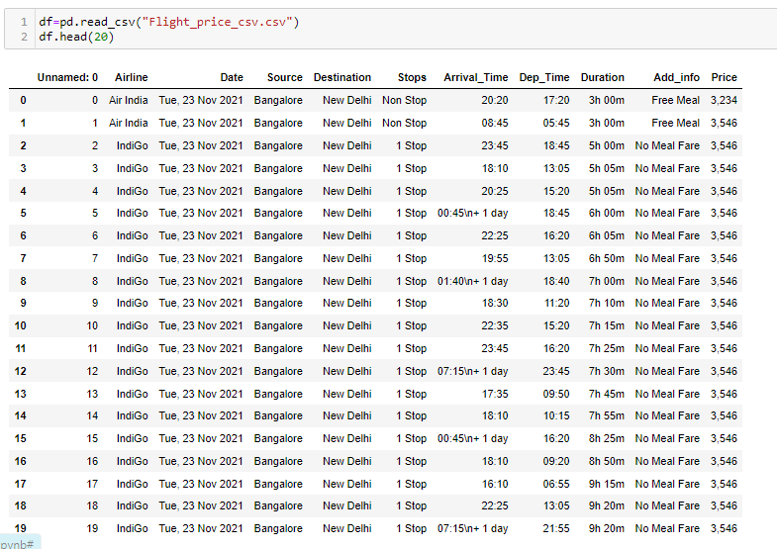
Load data set

Slide 5

Shape of the data set

Slide 6
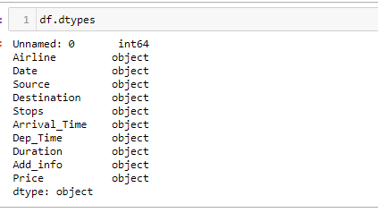
Checking data type of data set

Slide 7
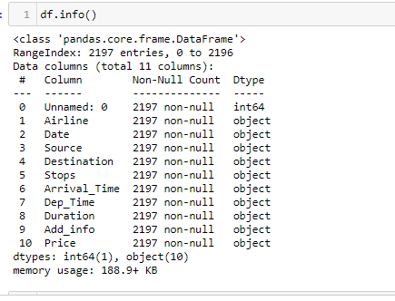
Short info about data set

Slide 8
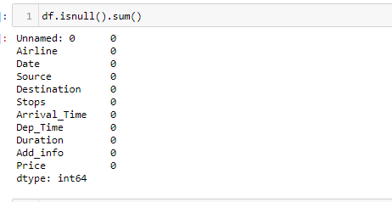
Checking missing values

Slide 9
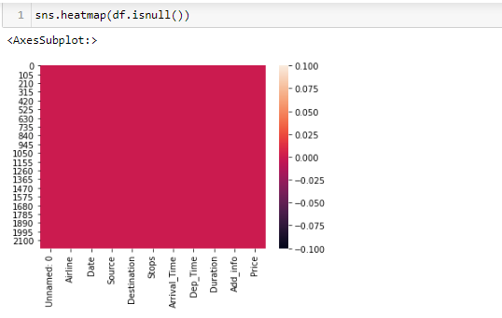

Slide 10
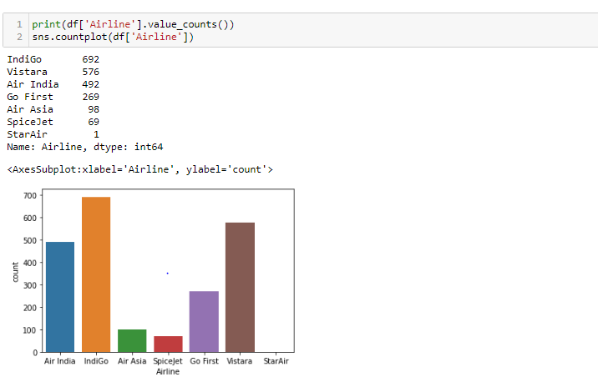
Visualization: airline column

Slide 11
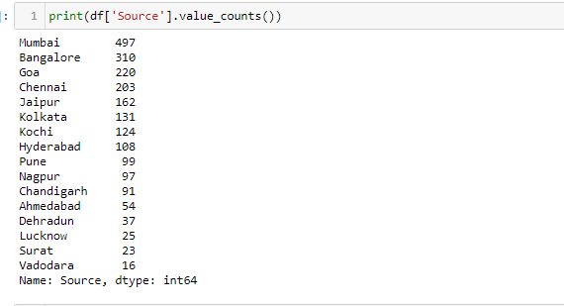
Source column

Slide 12
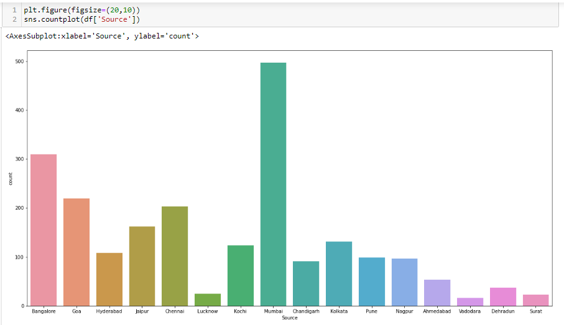

Slide 13
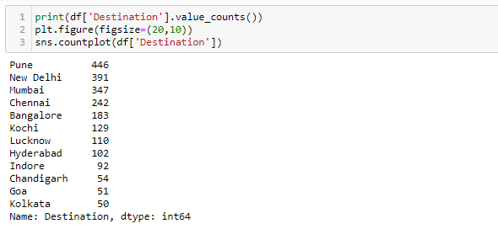
Destination column

Slide 14
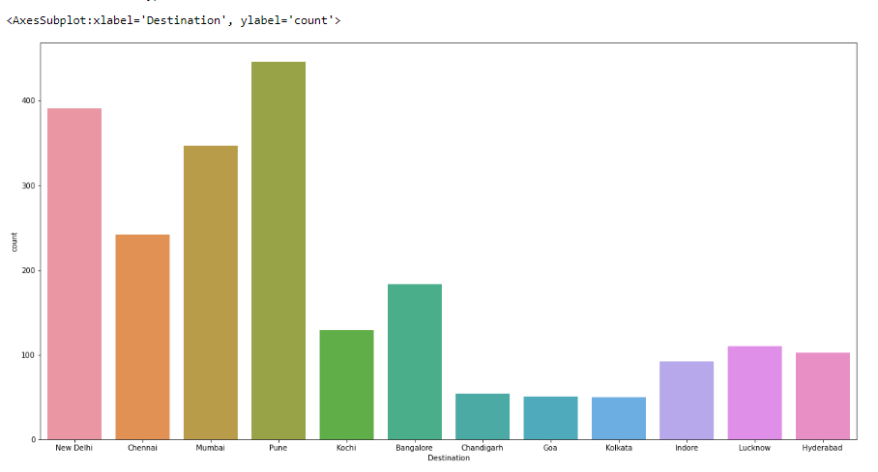

Slide 15
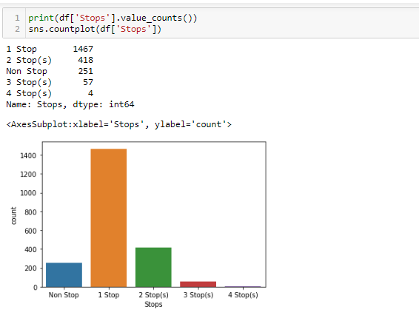
Stops column

Slide 16
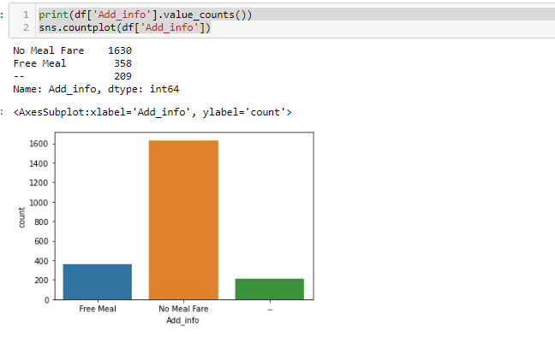
Addition values column

Slide 17
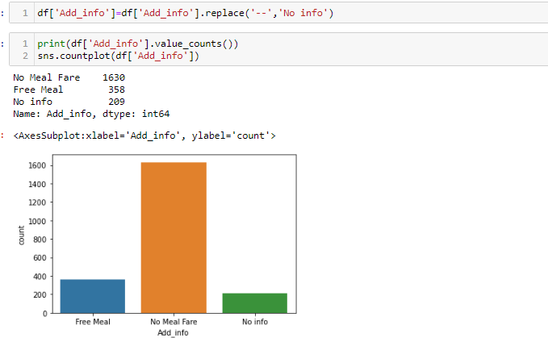

Slide 18
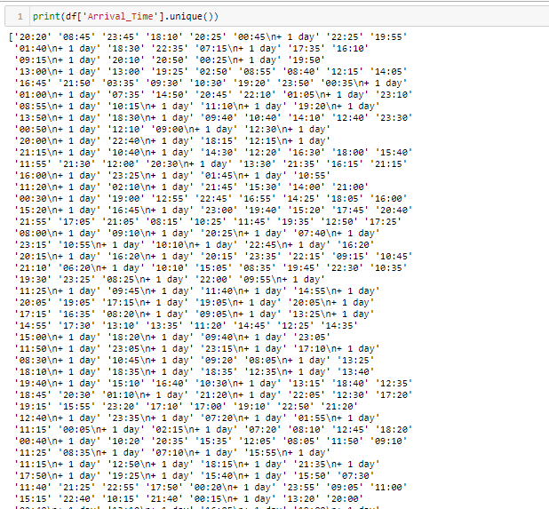
Arrival_time

Slide 19
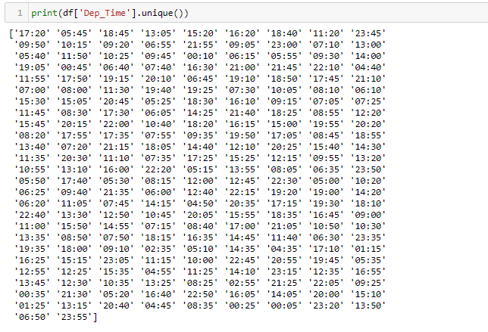
Departure time column

Slide 20
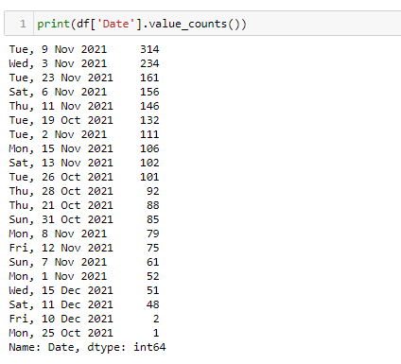
Date column

Slide 21
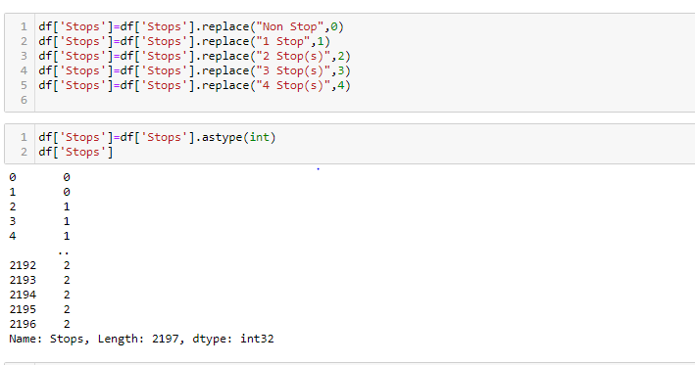
Data preprocessing

Slide 22
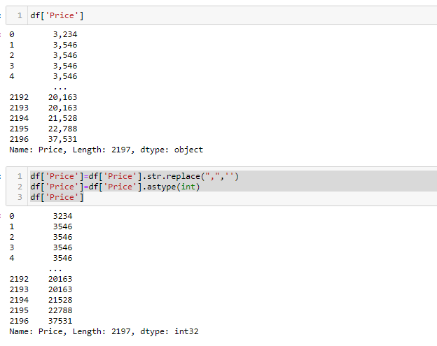
Price column

Slide 23
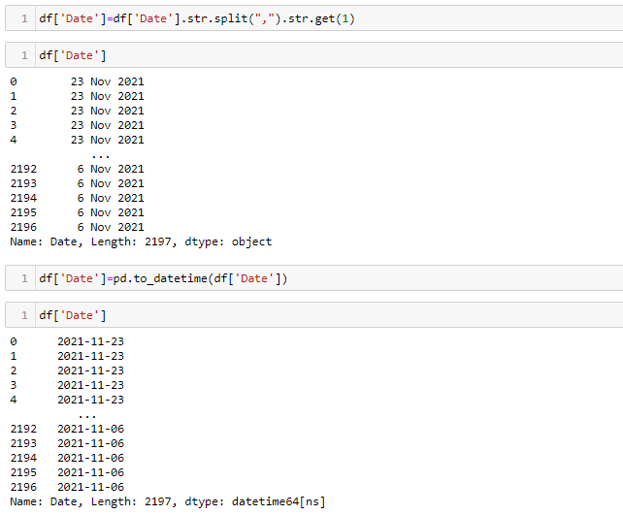
Date column

Slide 24
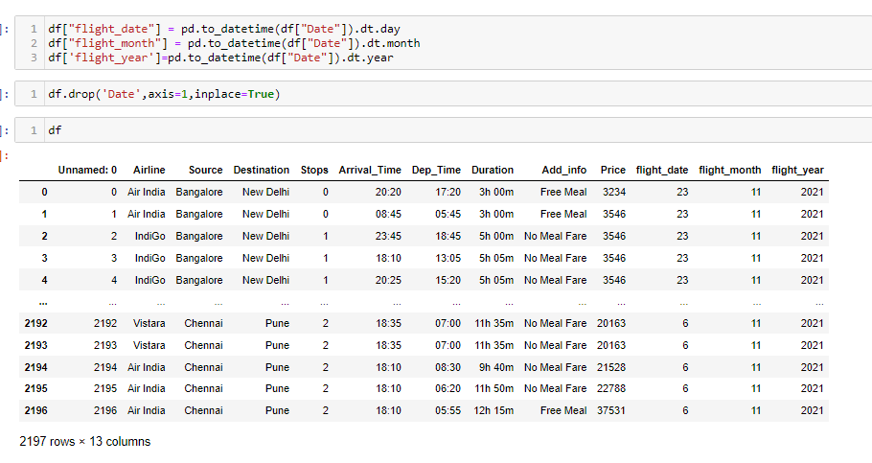
Deriving new columns

Slide 25
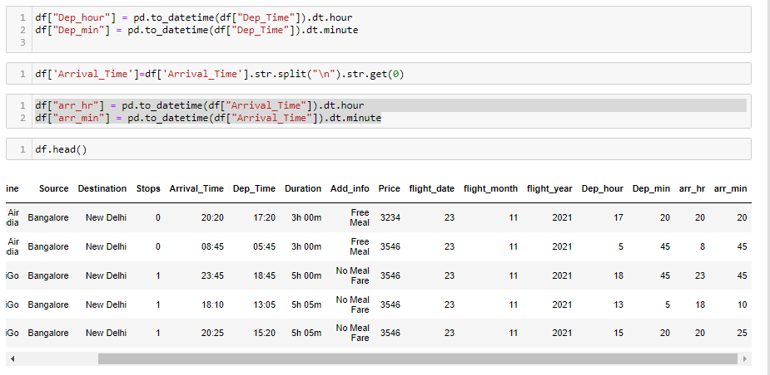

Slide 26
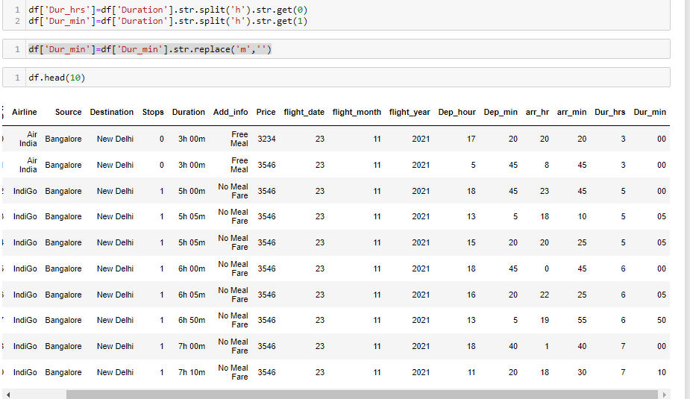

Slide 27
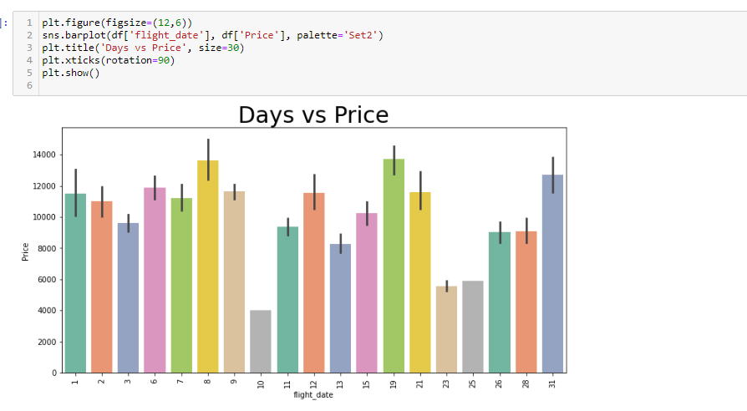
Days vs price

Slide 28
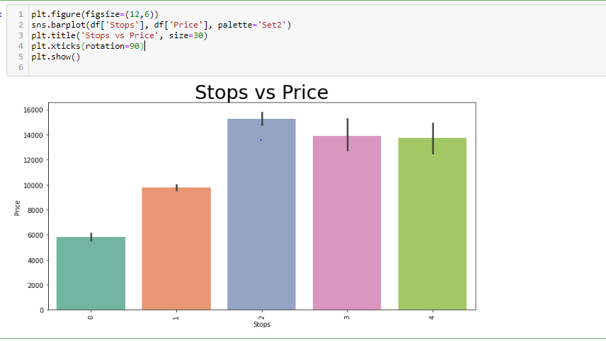
Stops vs price

Slide 29
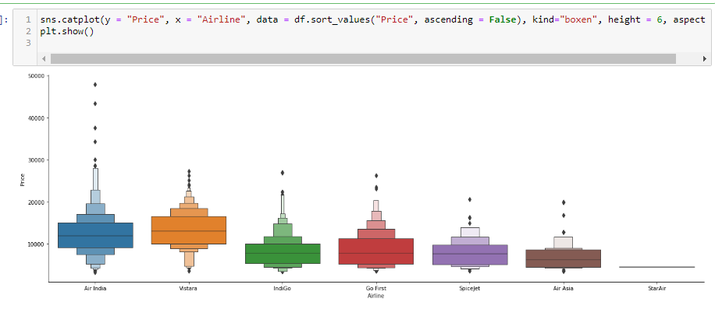
Airline vs price

Slide 30
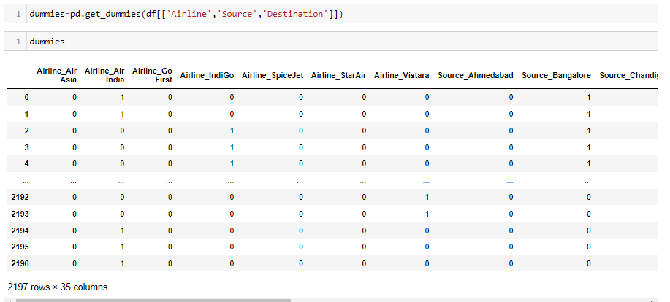
encoding

Slide 31
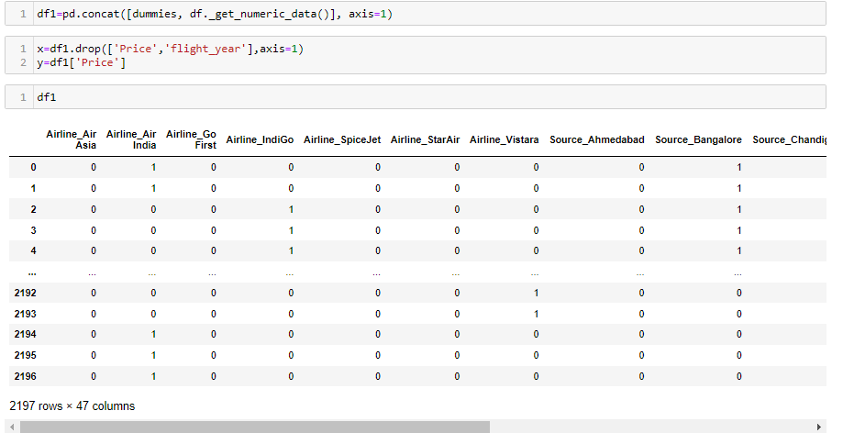

Slide 32
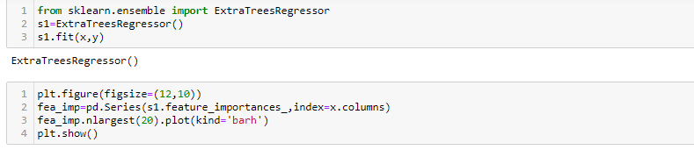
Feature importance

Slide 33
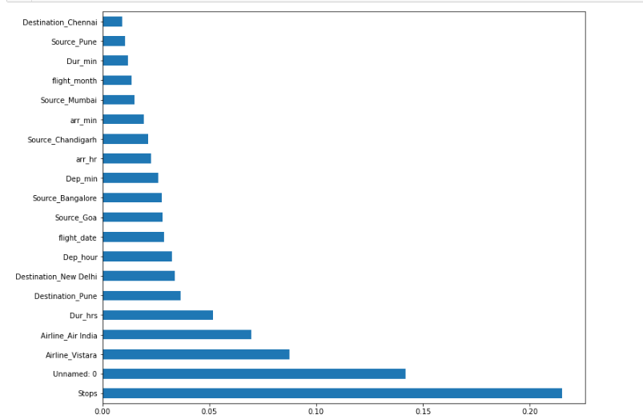

Slide 34
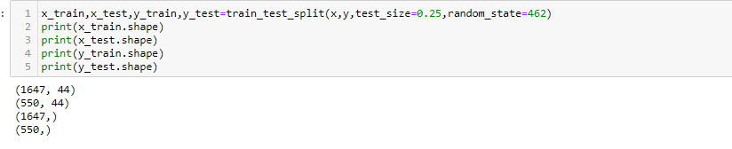
Train_test_split

Slide 35
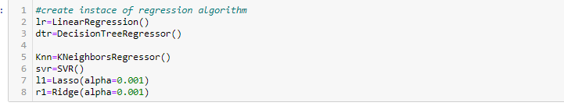

Slide 36
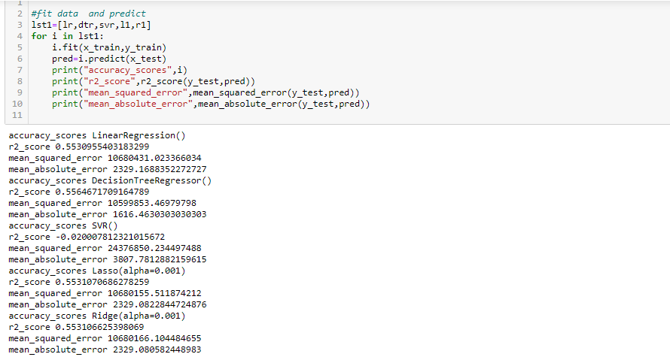
Fit and predict data

Slide 37
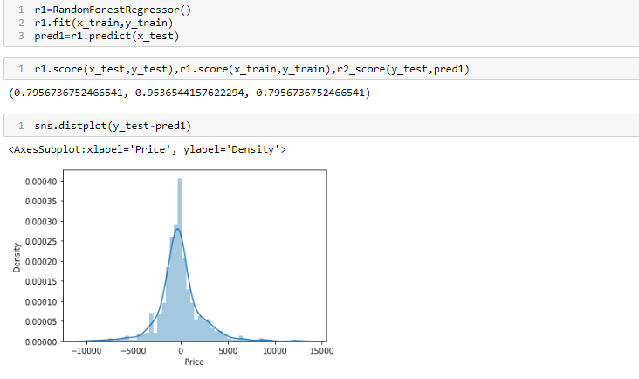

Slide 38
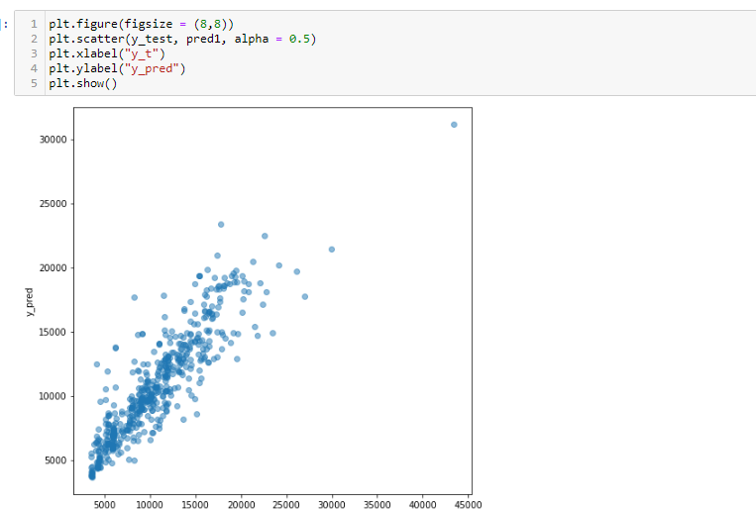

Slide 39
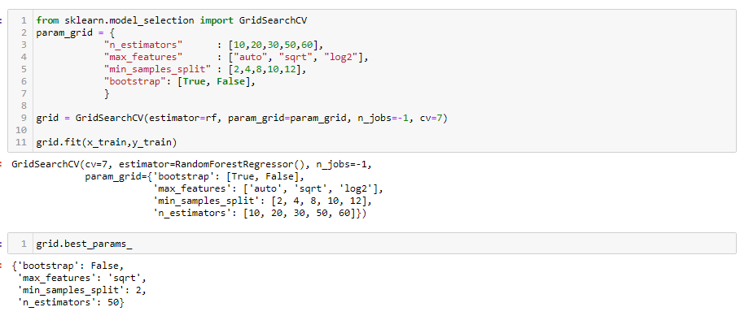
Hyper parameter tunning

Slide 40
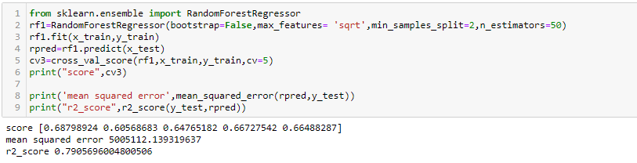

Slide 41
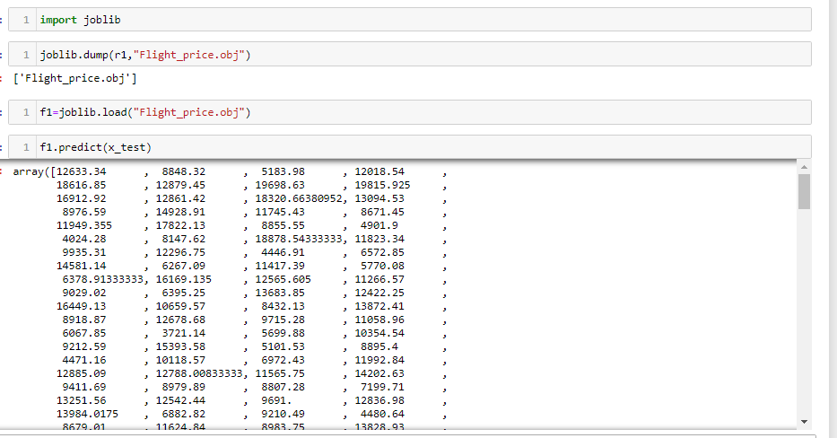
Create object file

Slide 42
CONCLUSION
To evaluate the conventional algorithm, a dataset is built for different routes and studied a trend of price variation for the period of limited days. Machine Learning algorithms are applied on the dataset to predict the dynamic fare of flights. This gives the predicted values of flight fare to get a flight ticket at minimum cost. Data is collected from the websites which sell the flight tickets so only limited information can be accessed. The values of R-squared obtained from the algorithm give the accuracy of the model. In the future, if more data could be accessed such as the current availability of seats, the predicted results will be more accurate

